Slide 1
© 2018 Cengage Learning®. May not be scanned, copied or duplicated, or posted to a publicly accessible website, in whole or in part.

Slide 2
Social Media
13
© 2018 Cengage Learning.® May not be scanned, copied or duplicated, or posted to a publicly accessible website, in whole or in part.

Slide 3
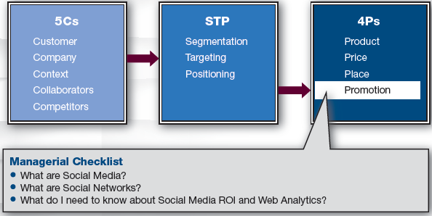
Marketing Framework

Slide 4
Discussion Question #1
Describe a social media campaign in which you have participated.

Slide 5
What Are Social Media?
Social media
People interacting and connecting with others via online software or alternative electronic access technologies
Traditionally, customers were recipients
With social media, customers now have dialogue with brands
Customers post endorsements and vent
Marketers have less control

Slide 6
Media Trends
Social media and mobile marketing are growing
Newspapers and magazines are declining
The number of radio stations is growing, but consumers listen less
The number of TV channels is growing
Fragmented audience facilitates targeting

Slide 7
Social Media Properties/Types
Some social media
Offer very rich, vivid sensory experiences: e.g., Virtual worlds, video games
Are simple: e.g., Blogs, forums
Are primarily social: e.g., Facebook
Are industrious: e.g., Wiki, LinkedIn
Vary in commerciality: e.g., Facebook has social content and ads for revenue

Slide 8
Discussion Question #2
Given the previous slides and a limited budget, how might you promote the launch of a new designer clothing label?

Slide 9
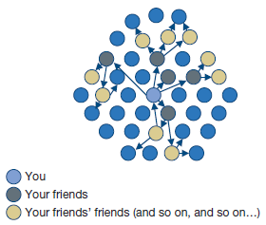
Word-of-Mouth (slide 1 of 2)
Social media facilitates word-of-mouth
Word-of-mouth is powerful and credible
Going viral; creating buzz

Slide 10
Word-of-Mouth (slide 2 of 2)
Word-of-mouth works well with
Exciting products
Clever ad campaigns
Humor, free give-aways, social causes
e.g., Geico Gecko has Facebook friends
Extraverted consumers
Consumers with large social networks

Slide 11
Social Networks
Sociogram: networks in graphical form
The set of actors and relational ties
Actors may be customers, firms, brands, etc.
Ties can be symmetric
e.g., Joe and Sally are coworkers
Ties can be directional
e.g., Joe likes Sally
Ties vary in strength
Network analysis requires tabular representation (sociomatrix)

Slide 12
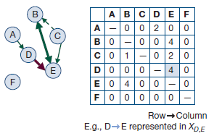
Social Network Example
Strong mutual link between actors B and E
Weak unidirectional link from C to B
F is isolated
B, C, and E form a group

Slide 13
Identifying Influentials (slide 1 of 3)
In social networks, some members are more connected & influential than others
Goal is to locate highly influential members, induce their trial of products, and propel the diffusion process
Locating central members
Centrality indices are computed for each actor in the network to describe the position of that actor relative to the others

Slide 14
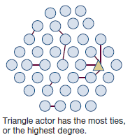
Identifying Influentials (slide 2 of 3)
Centrality: Number of connections each actor has with the others
Centrality index
Central = many links
Peripheral = fewer links

Slide 15
Identifying Influentials (slide 3 of 3)
Cliques
Groups of people in the network
Common in brand communities, affinity groups, cell phone friend networks, etc.

Slide 16
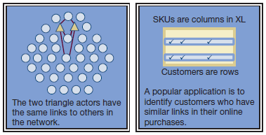
Recommendation Systems (slide 1 of 2)
Structural equivalence
Two customers are equivalent if their purchase patterns are the same
Used in recommendation agents

Slide 17
Recommendation Systems (slide 2 of 2)
Result of social media
Data of purchase patterns or ratings are aggregated over many people
Customers trust online recommendations
It is more authentic than advertising
Resistance
Conservative, older CEOs don’t spend money on something they don’t understand

Slide 18
Social Media ROI
Social media seems free but is not
Main cost may be salaries for thought and labor
Key performance indicators (KPIs)
Reach, frequency, monetary value of customers, customers’ behaviors, attitudes, memory, etc.

Slide 19
Social Media ROI: Awareness
Pre-purchase: awareness
Reach can be achieved via
Traditional media and measured online
e.g., Magazine tells reader to learn more by going to a particular Web page
Online and measured online
e.g., Web ads, search engine status
Media that optimize reach
Twitter, Facebook, YouTube

Slide 20
Social Media ROI: Brand Consideration (slide 1 of 3)
Pre-purchase: brand consideration
Offer more information to build knowledge and persuade
Use media that give more content
e.g., Search engine ad placement, podcasts, post information in brand community, give customer testimonials

Slide 21
Social Media ROI: Brand Consideration (slide 2 of 3)
Pre-purchase: brand consideration (continued)
Search engine optimization (SEO)
Consumers search when they don’t have a preferred brand
Keywords depend on customer knowledge
To improve SEO
Put meaningful keywords in Web page title
Order the words with most important first

Slide 22
Social Media ROI: Brand Consideration (slide 3 of 3)
Pre-purchase: brand consideration (continued)
Key Web analytics
Frequency: number of visits and number of unique visitors
Duration: time spent per page and overall time spent on the site
Bounce rates: percent of one page visits
Conversion rates: when a visitor transitions from a looker to a doer

Slide 23
Social Media ROI: Purchase/Behavior (slide 1 of 3)
Purchase/behavioral engagement
Induce any action that engages the prospective customer
What do they open, what do they download?
Do they watch demos that may be available?
How much time are they spending on which purchase-related pages?
Do they register to subscribe to newsletters?
Instead of “Contact Us” marketers prefer forms that capture specific information

Slide 24
Social Media ROI: Purchase/Behavior (slide 2 of 3)
Purchase/behavioral engagement (continued)
KPIs may include
Number of posts about the brand
Audience build as measured by incoming links and the speed of that growth
Conversion rates: frequencies of Web visitors to engage in the focal behavior relative to the number of visitors who come to the website

Slide 25
Social Media ROI: Purchase/Behavior (slide 3 of 3)
Costs of the actions depend on goals
Estimates of acquisition costs; payment for placement in search engines or banner ads, sending emails from a rented address database, etc.
Effectiveness of actions can be assessed by frequencies, rates, and durations

Slide 26
ROI for Social Media: Post-Purchase
Post-purchase
Satisfied customers
Customers may post positive reviews, give endorsements, etc.
Dissatisfied customers
Company can read complaints, address issues, give incentives, etc.

Slide 27
How to Proceed (slide 1 of 3)
Engaging in all social media is not desirable
Some media fit marketing goals and target market better than others
Social media require maintenance and constant activity

Slide 28
How to Proceed (slide 2 of 3)
Companies can learn by lurking or Web crawling
Monitoring tweets, blogs, and discussions
Analyzing text on Facebook to understand customers’ opinions about brands
Search brand’s page or search for brand name on other postings
Analyzing content to detect consumer trends
Checking websites for misinformation

Slide 29
How to Proceed (slide 3 of 3)
Companies can actively create interventions
Enter online communities and ask for volunteers for beta testing
Experiment to measure the effect of changes in the marketing mix
Measure attitudes, click-through rates, sign-up rates, etc.
Use GPS data to track customers and give offers

Slide 30
Discussion Questions #3
You are a marketing manager for Nike. Discuss a social media plan to
Learn about your customers.
Encourage trial.

Slide 31
Managerial Recap (slide 1 of 2)
Social networks are an important and provocative channel
Social media are Web-based means of interacting with others by posting opinions, pictures, and videos
Social networks are the structures of interconnections among customers that propagate word-of-mouth

Slide 32
Managerial Recap (slide 2 of 2)
Networks can be analyzed
Social media ROI and KPIs can be computed with the help of online analytics after the marketing goals are understood

